Slide 1
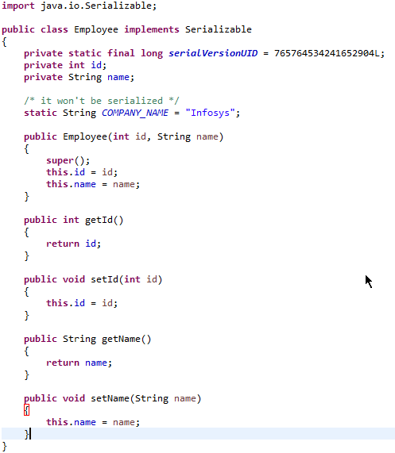
Java Serialization with static data member
If there is any static data member in a class, it will not be serialized because static is the part of class not object.

